Slide 1

CHAPTER 4
ELEMENTARY
NUMBER THEORY
AND METHODS
OF PROOF
Copyright © Cengage Learning. All rights reserved.

Slide 2
SECTION 4.3
Direct Proof and Counterexample III: Divisibility
Copyright © Cengage Learning. All rights reserved.

Slide 3
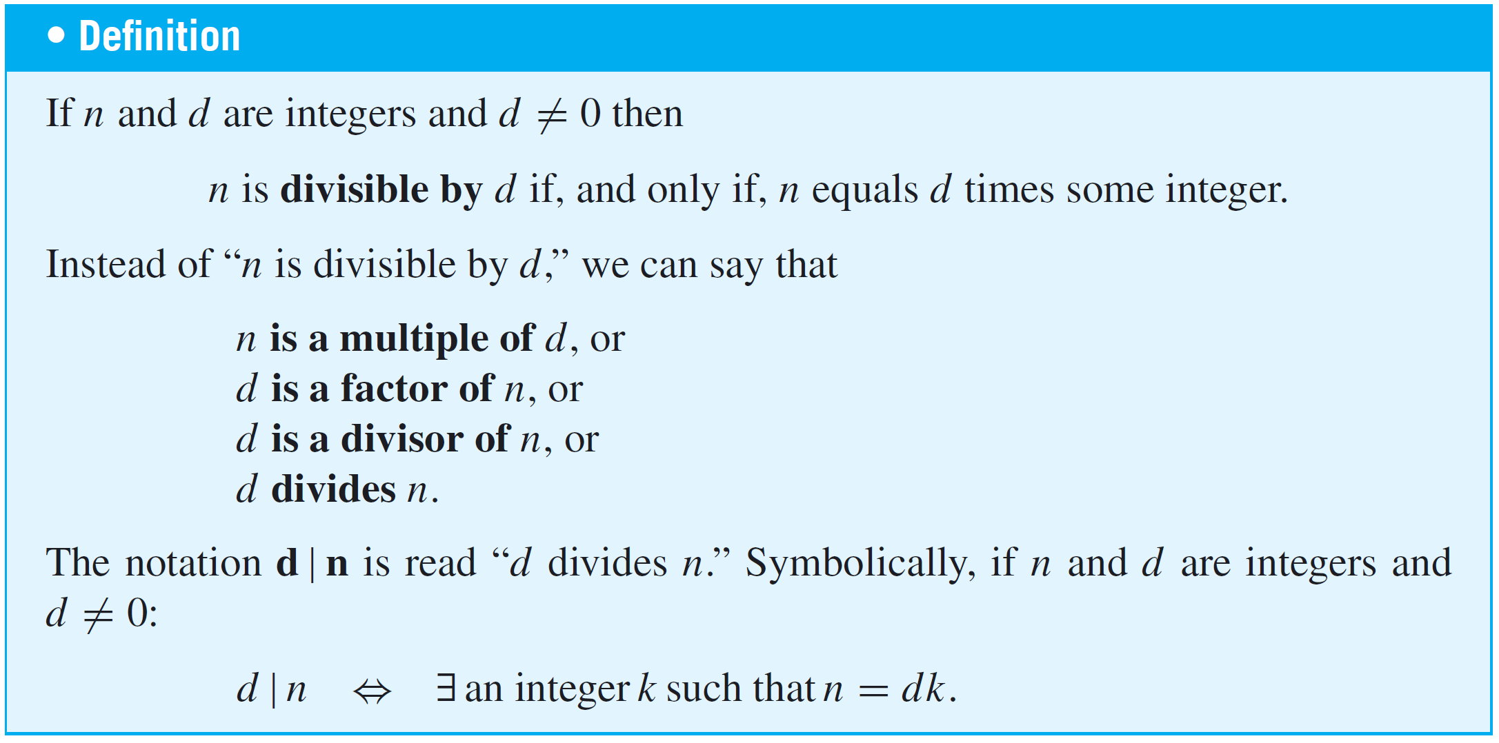
Direct Proof and Counterexample III: Divisibility
The notion of divisibility is the central concept of one of the most beautiful subjects in advanced mathematics: number theory, the study of properties of integers.

Slide 4
Example 1 – Divisibility
a. Is 21 divisible by 3?
b. Does 5 divide 40?
c. Does 7 | 42?
d. Is 32 a multiple of −16?
e. Is 6 a factor of 54?
f. Is 7 a factor of −7?

Slide 5
Example 1 – Solution
a. Yes, 21 = 3  7.
b. Yes, 40 = 5  8.
c. Yes, 42 = 7  6.
d. Yes, 32 = (−16)  (−2).
e. Yes, 54 = 6  9.
f. Yes, −7 = 7  (−1).

Slide 6
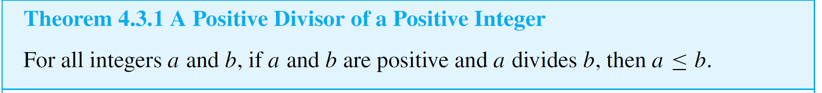
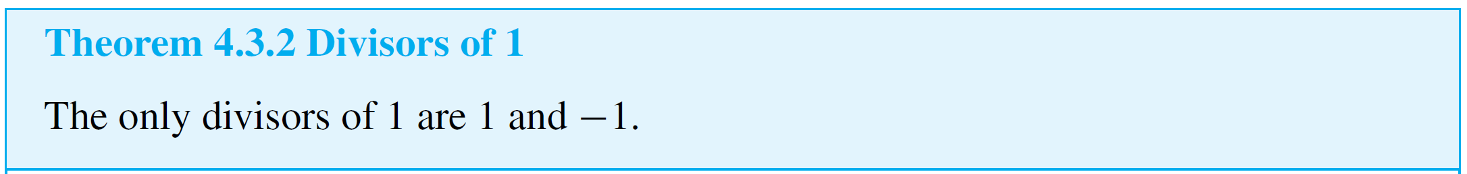
Direct Proof and Counterexample III: Divisibility
Two useful properties of divisibility are (1) that if one positive integer divides a second positive integer, then the first is less than or equal to the second, and (2) that the only divisors of 1 are 1 and −1.

Slide 7
Example 1 – Divisibility of Algebraic Expressions
a. If a and b are integers, is 3a + 3b divisible by 3?
b. If k and m are integers, is 10km divisible by 5?
Solution:
a. Yes. By the distributive law of algebra, 3a + 3b = 3(a + b)
and a + b is an integer because it is a sum of two
integers.
b. Yes. By the associative law of algebra, 10km = 5  (2km)
and 2km is an integer because it is a product of three
integers.

Slide 8

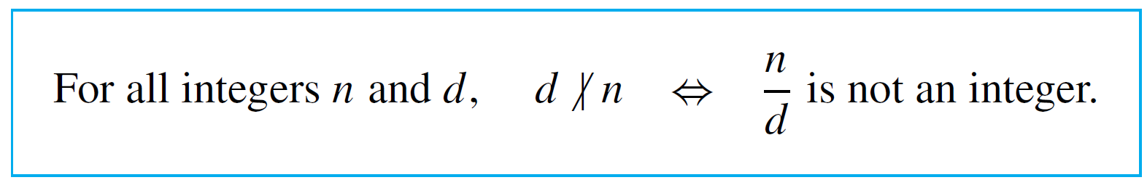
Direct Proof and Counterexample III: Divisibility
When the definition of divides is rewritten formally using the existential quantifier, the result is
Since the negation of an existential statement is universal, it follows that d does not divide n (denoted ) if, and only if, ∀ integers k, n ≠ dk, or, in other words, the quotient n/d is not an integer.

Slide 9
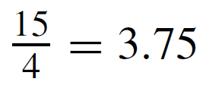
Example 4 – Checking Nondivisibility
Does 4 | 15?
Solution:
No, , which is not an integer.

Slide 10
Proving Properties of Divisibility

Slide 11
Proving Properties of Divisibility
One of the most useful properties of divisibility is that it is transitive. If one number divides a second and the second number divides a third, then the first number divides the third.

Slide 12
Example 6 – Transitivity of Divisibility
Prove that for all integers a, b, and c, if a | b and b | c, then a | c.
Solution:
Since the statement to be proved is already written formally, you can immediately pick out the starting point, or first sentence of the proof, and the conclusion that must be shown.
Starting Point: Suppose a, b, and c are particular but
arbitrarily chosen integers such that a | b
and b | c.

Slide 13
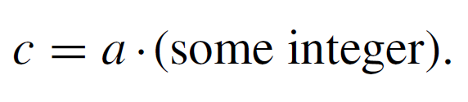
Example 6 – Solution
cont’d
To Show: a | c.
You need to show that a | c, or, in other words, that
But since a | b,
And since b | c,
Equation 4.3.2 expresses c in terms of b, and equation 4.3.1 expresses b in terms of a.

Slide 14



Example 6 – Solution
cont’d
Thus if you substitute 4.3.1 into 4.3.2, you will have an equation that expresses c in terms of a.
But (ar)s = a(rs) by the associative law for multiplication. Hence
Now you are almost finished.

Slide 15
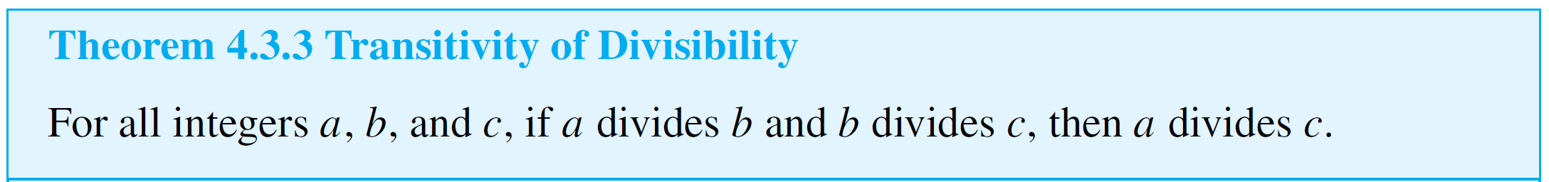
Example 6 – Solution
cont’d
You have expressed c as a  (something). It remains only to verify that that something is an integer. But of course it is, because it is a product of two integers.
This discussion is summarized as follows:

Slide 16



Example 6 – Solution
cont’d
Proof:
Suppose a, b, and c are [particular but arbitrarily chosen] integers such that a divides b and b divides c. [We must show that a divides c.] By definition of divisibility,
By substitution

Slide 17

Example 6 – Solution
cont’d
Let k = rs. Then k is an integer since it is a product of integers, and therefore
Thus a divides c by definition of divisibility. [This is what was to be shown.]

Slide 18
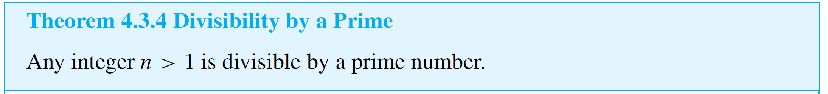
Proving Properties of Divisibility

Slide 19
Counterexamples and Divisibility

Slide 20
Counterexamples and Divisibility
To show that a proposed divisibility property is not universally true, you need only find one pair of integers for which it is false.

Slide 21
Example 7 – Checking a Proposed Divisibility Property
Is the following statement true or false? For all integers a and b, if a | b and b | a then a = b.
Solution:
This statement is false. Can you think of a counterexample just by concentrating for a minute or so?
The following discussion describes a mental process that may take just a few seconds. It is helpful to be able to use it consciously, however, to solve more difficult problems.

Slide 22
Example 7 – Solution
cont’d
To discover the truth or falsity of the given statement, start off much as you would if you were trying to prove it.
Starting Point: Suppose a and b are integers such that
a | b and b | a.
Ask yourself, “Must it follow that a = b, or could it happen that a ≠ b for some a and b?” Focus on the supposition. What does it mean? By definition of divisibility, the conditions a | b and b | a mean that

Slide 23


Example 7 – Solution
cont’d
Must it follow that a = b, or can you find integers a and b that satisfy these equations for which a ≠ b? The equations imply that
Since b | a, b ≠ 0, and so you can cancel b from the extreme left and right sides to obtain
In other words, k and l are divisors of 1. But, by Theorem 4.3.2, the only divisors of 1 are 1 and –1. Thus k and l are both 1 or are both –1. If k = l = 1, then b = a.

Slide 24
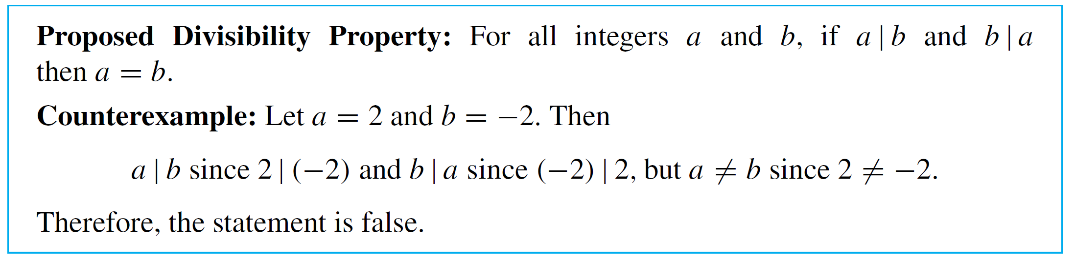
Example 7 – Solution
cont’d
But if k = l = –1, then b = –a and so a ≠ b.
This analysis suggests that you can find a counterexample by taking b = –a.
Here is a formal answer:

Slide 25
The Unique Factorization
of Integers Theorem

Slide 26
The Unique Factorization of Integers Theorem
The most comprehensive statement about divisibility of integers is contained in the unique factorization of integers theorem.
Because of its importance, this theorem is also called the fundamental theorem of arithmetic.
The unique factorization of integers theorem says that any integer greater than 1 either is prime or can be written as a product of prime numbers in a way that is unique except, perhaps, for the order in which the primes are written.

Slide 27
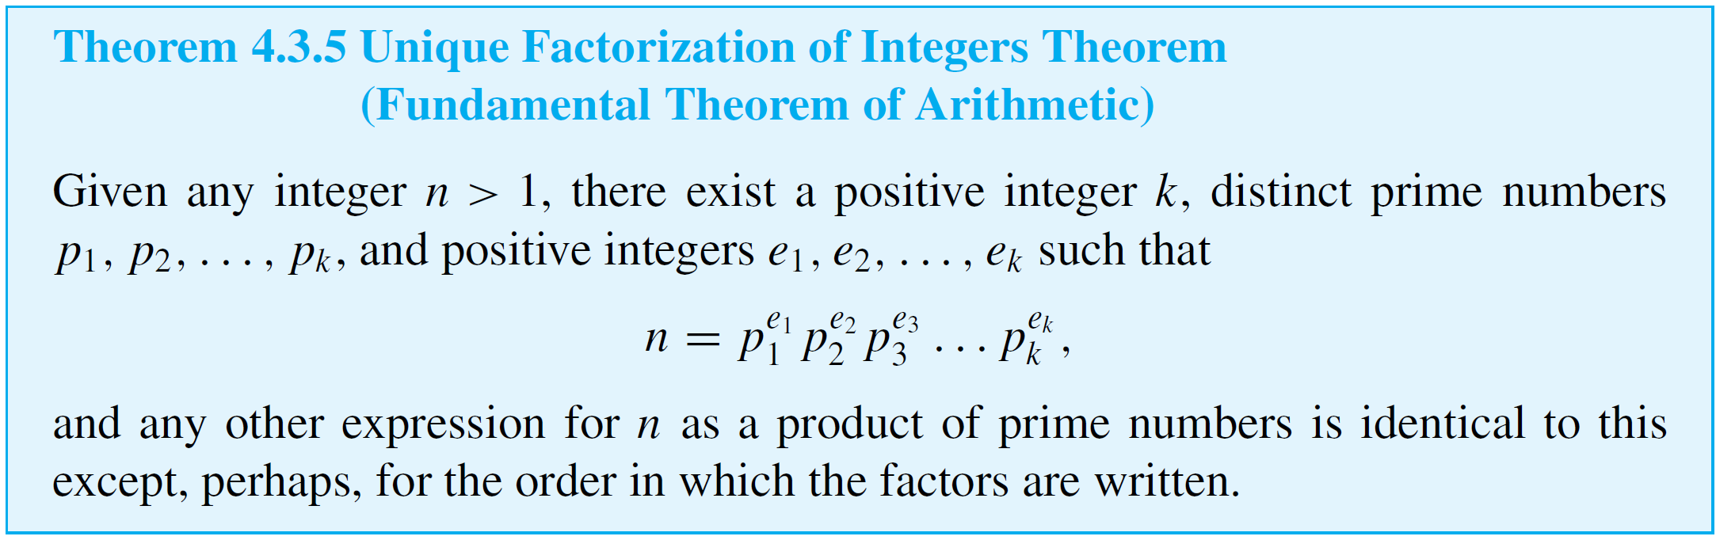
The Unique Factorization of Integers Theorem

Slide 28
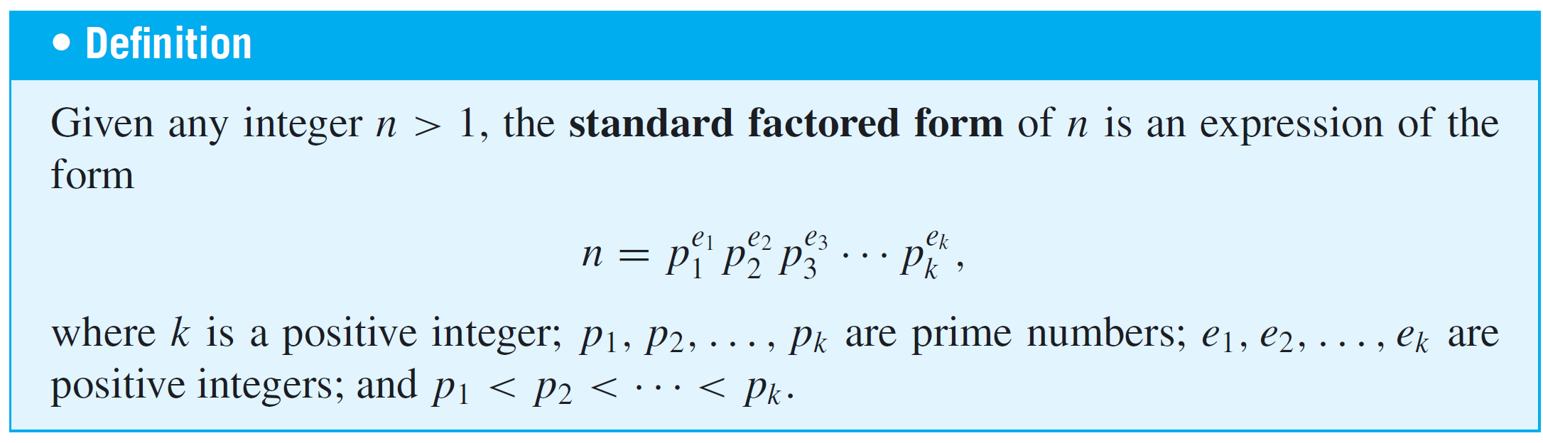
The Unique Factorization of Integers Theorem
Because of the unique factorization theorem, any integer n > 1 can be put into a standard factored form in which the
prime factors are written in ascending order from left to right.

Slide 29
Example 9 – Using Unique Factorization to Solve a Problem
Suppose m is an integer such that
Does 17 | m?
Solution:
Since 17 is one of the prime factors of the right-hand side of the equation, it is also a prime factor of the left-hand side (by the unique factorization of integers theorem).
But 17 does not equal any prime factor of 8, 7, 6, 5, 4, 3, or 2 (because it is too large). Hence 17 must occur as one of the prime factors of m, and so 17 | m.

